Slide 1
ist 263
Layout Day 2

Slide 2
Agenda
Exam Wednesday
Flexbox
Centering Horizontally
More Flexbox

Slide 3
Flexbox

Slide 4
What is Flexbox?
A way of laying out elements on a web page.
Elements/containers are laid out in rows and columns.

Slide 5
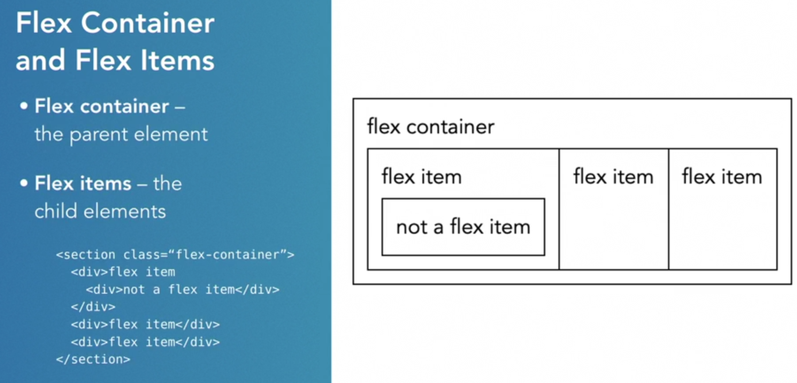

Slide 6
Properties for Flexbox
Property | Value(s) | Example
display | flex | div {display: flex;} | Children of this container are going to display side by side
flex | 1, 2, 3 … | div {flex: 1;} | Sets ratio size of container in row
flex-basis | 20%, 30%,… | div {flex-basis: 20%;} | Sets percentage size of container in row
order | 1, 2, 3 … | div {order: 1} | Defines order of container in row
justify-content | space-between | div {justify-content: space-between;} | Defines where extra space between containers will display
flex-wrap | wrap | div {flex-wrap: wrap;} | By default, flex items will all try to fit onto one line. You can change that and allow the items to wrap as needed with this property.
https://css-tricks.com/snippets/css/a-guide-to-flexbox/

Slide 7
Centering

Slide 8
Centering Inline Elements
text-align: center;

Slide 9
Centering Block Elements
Block elements take up 100% of the page width by default so you must first set a width or it won’t look like anything happened.
width: 30%;
margin: 0 auto;

Slide 10
Centering With Flexboxes
display: flex;
justify-content: center;

Slide 11
More Flexbox

Slide 12
Flex-End
justify-content: flex-end;

Slide 13
Space-Around
justify-content: space-around;

Slide 14
Space-Between
justify-content: space-between;

Slide 15
Elements on the Left and Right
2 Flexboxes inside a Flexbox with:
justify-content: space-between;

Slide 16
Breaking Down Complex Layouts

Slide 17
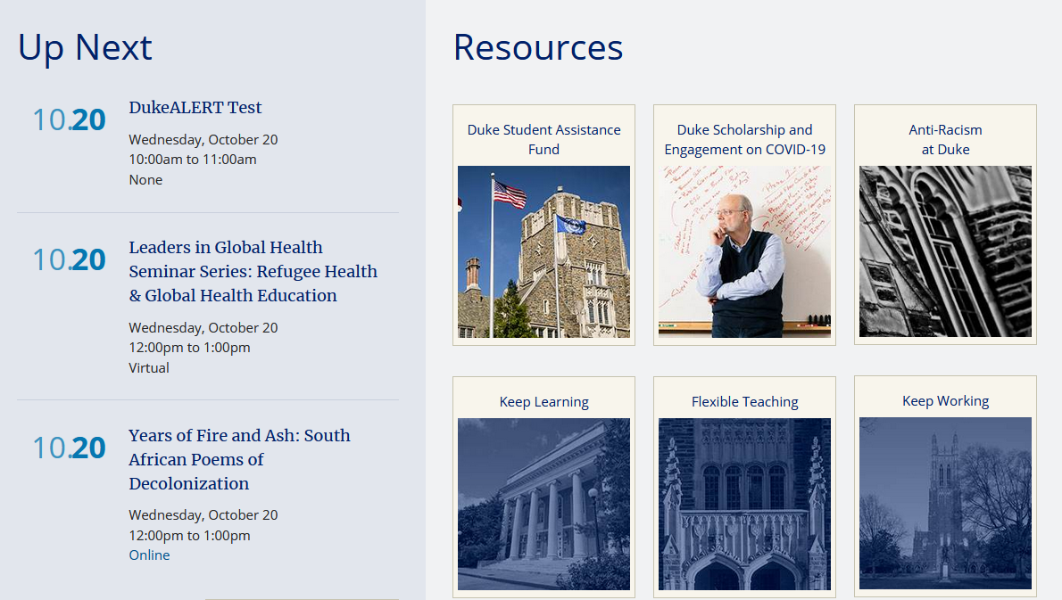
Examine This Design
https://duke.edu/

